Slide 1
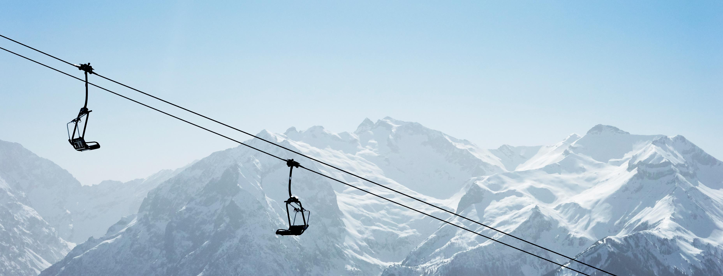
Big Mountain Resort: Data-Driven Ticket Pricing & Investment Strategy Report
November 19, 2025
Presented by: Gayathri Ramani

Slide 2
Big Mountain Resort: Key Questions
Where should we invest to strengthen pricing power?
Are we underpricing compared to other U.S. ski resorts?
What resort features most influence ticket prices?

Slide 3
Big Mountain Resort: Pricing & Revenue Optimization
Determine if current weekend ticket price reflects true market value
Set a competitive, data-driven price for next season
Identify opportunities for revenue growth and operational investment
Revenue target: Increase by 10% next fiscal year
Notes:
Revenue target: Increase by 10% next fiscal year

Slide 4
Recommendation & Key Insights
Primary Recommendation:
Increase weekend ticket price from $81 to approximately $96 (model-predicted optimal price).
Why?
  Model strongly indicates the resort is undervalued relative to peers.
  Big Mountain’s infrastructure profile ranks high among competitors (vertical drop, chairs, snowmaking, fast quads).
Key Findings:
  Random Forest produced best accuracy (MAE ~ $8–$10).
  Vertical Drop is the most impactful pricing driver.
  Expanding vertical drop raises optimal price by ~$8.61, the largest investment payoff.

Slide 5
Data & Approach Overview
Dataset
  330 ski resorts, 27 variables
  After cleaning: 277 resorts, 25 feature variables
Target variable
  Weekend Adult price
Core variables
  Terrain, number of lifts, snowmaking, resort size, resort infrastructure, season length
Methodology
  Data cleaning & pre-processing
  Exploratory data analysis
  Feature engineering
  Modeling & validation (Linear Regression, Random Forest)
  Scenario modeling
  Pricing & Investment recommendations

Slide 6
Drivers of Ticket Price
Top predictors identified:
  Vertical drop
  Snowmaking capacity
  Number of fast quads
  Total chairs and runs
  Skiable terrain
  Availability of night skiing
Insights:
  Strong correlations between terrain and lift infrastructure capacity and pricing.
  PCA showed that 75%+ of variance explained by first two components

Slide 7
Model Performance
Baseline Mean Model:
  MAE ≈ $19 → validated need for ML-based modeling.
Models Tested:
  Linear Regression (scaled features)
  Random Forest Regressor
Performance Summary:
  Linear Regression: MAE ≈ $9
  Random Forest: MAE ≈ $8
  Random Forest chosen for stability, accuracy, and ability to capture nonlinear relationships.

Slide 8
Optimal Price Prediction
Big Mountain Current Price: $81
Predicted Market-Aligned Price: $95.87
Interpretation:
Even after accounting for error range, the model strongly indicates significant underpricing.
Comparative Positioning:
  High vertical drop
  Strong snowmaking
  High number of chairs and runs
  Competitive resort infrastructure→ Justifies higher price.

Slide 9
Scenario Modeling
Most Impactful Scenario: Vertical Drop Expansion
  Increases predicted ticket price by ≈ $8.61.
Additional Add-ons:
  Snowmaking expansion → marginal additional benefit (~$1.29 increase).
  Run changes, longest-run extensions → minimal price impact.
Takeaway:
  Vertical drop expansion is the highest ROI investment for strengthening pricing power.

Slide 10
Conclusion & Next Steps
Conclusion:
  Big Mountain Resort is likely underpricing relative to market value.
  A data-aligned pricing increase and strategic investment in vertical drop expansion positions the resort to achieve its 10% revenue growth target.
Next Steps:
  Phased price increase with ongoing customer-feedback monitoring
  Feasibility study for vertical drop expansion
  Competitor research & willingness-to-pay surveys
  Consider integrating operational costs and visitor demographics into next model iteration
  Build real-time scenario simulation dashboard for leadership

